Slide 1
Perceptron update rules
Intro to backpropagation and example

Slide 2










The Perceptron Model
Equation:
Activation: Step function f(z) = 1 if z ≥ 0; -1 otherwise.
If predicts whether an input, X_{i}, has a label of 1 or 0.
Update rule
If the prediction is correct, do nothing.
If the prediction is wrong, then:
W = W + X; b = b + 1 it was labelled as 0 but should be 1
W = W – X; b = b - 1 it was labelled as 1 but should be 0

Slide 3
Summary
The perceptron is a linear classifier
Has an activation
Weights are updated using a rule
No gradient is used to update the weights

Slide 4
Toward the MLP
We will add multiple neurons arranged in hidden layers.
This setup allows us to learn decision boundaries that are non linear.
The weights of each neuron are updated using gradient-based optimization.
The gradients are calculated using backpropagation.

Slide 5
The chain rule
In more detail and for a simpler example

Slide 6

















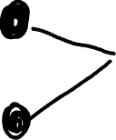






Slide 7

























Slide 8




























Slide 9








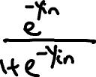









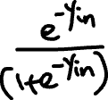




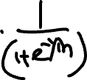










Slide 10

















Slide 11


































Slide 12
























Slide 13




















Slide 14

























Slide 15
Now use gradient descent to update the weights
And keep doing this until the loss is satisfactory

Slide 16
Math is awesome!
Mathematics from the 1600s-1800s (calculus, derivatives, chain rule) turned out to be exactly what we needed centuries later to teach machines to learn.
Backpropagation is just repeated application of the chain rule.
Yet works so well for training neural networks that can now recognize images, translate languages, and have conversations!!

Slide 17
Another example
This new example has 1 input layer, 1 hidden layer with 2 neurons, and 1 output layer

Slide 18










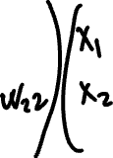























Slide 19






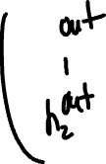









Slide 20



































Slide 21






















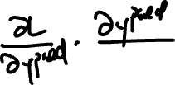






Slide 22



















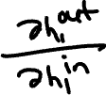



















Slide 23




























Slide 24




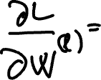

Slide 25
